Slide 1
EEE 473-573 Medical Imaging Project Presentation MRI Simulator & Demonstration of Non-Idealities and Effects of Scanning Parameters
Efe eren Ceyani – 21903359
Batuhan uykulu – 21802986
MERT ALTUNSOY - 22101161

Slide 2
Introduction
Ideal MRI simulation process.
Adding non-ideal cases to the simulation.
Observing several artifacts by changing parameters.

Slide 3
Methods - Dataset
Brain Web dataset, which has a discrete model for normal brain with 10 different pixel labels.
Realistic inhomogeneous B₀ fields.

Slide 4
Methods - Simulation
Slice selection with unrealistic RF pulse.
K-space acquisition using the effective spin density.
Image reconstruction using inverse 2D Fourier transform.

Slide 5
Results – Different Contrasts

Slide 6
Results – Different Contrasts

Slide 7
Results – Different Contrasts

Slide 8
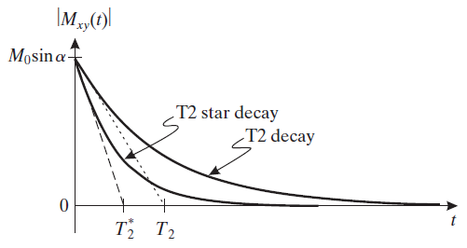
Results – T₂ and T₂*

Slide 9
Results – T₂ and T₂*

Slide 10
Results – B₀ inhomogeneity

Slide 11
Results – Noise

Slide 12
Results – Noise

Slide 13
Results – Noise

Slide 14
Results – Spike Noise Artifact

Slide 15
Results – Wrap Around Artifact

Slide 16
Results – Slice Location & Thickness

Slide 17
Results – Slice Location & Thickness

Slide 18
References
https://brainweb.bic.mni.mcgill.ca/
Chavhan GB et al (2009). Principles, techniques, and applications of T2*-based MR imaging and its special applications. Radiographics, 29.
Nishimura, D. G. (2010). Principles of Magnetic Resonance Imaging. Lulu.com.
Prince, J. L., & Links, J. M. (2015). Medical Imaging Signals and Systems (2nd ed.). Pearson.

